Slide 1
Introduction to iPhone
Chapter - 10

Slide 2
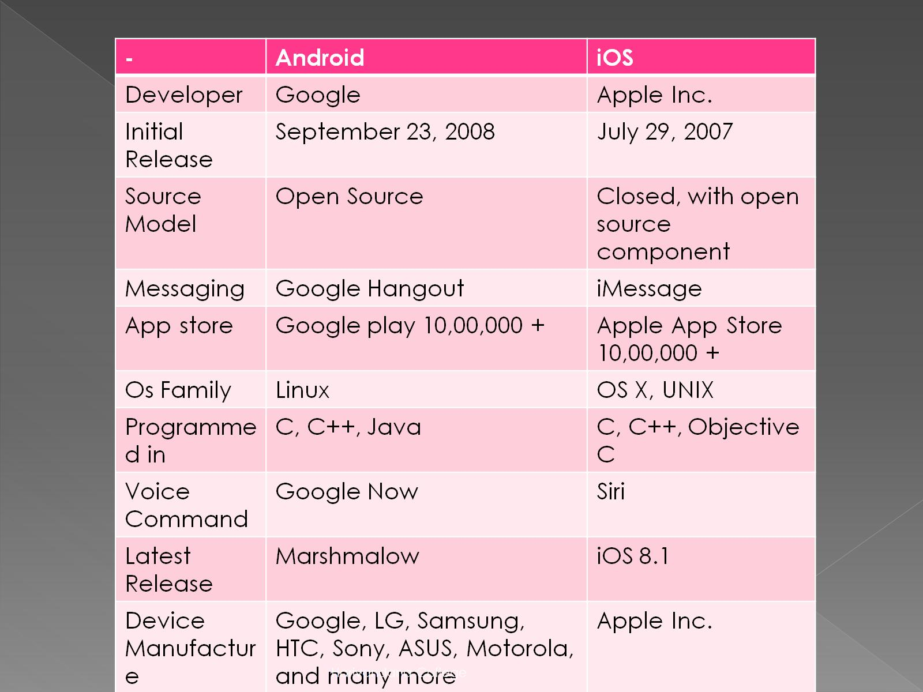
Comparison between android & iOS

Slide 3
Introduction to X-code(IDE)
Xcode is an integrated development environment(IDE) containing a suite of software development tools developed by Apple for developing software for OS x and iOS First release in 2003.

Slide 4
Editor Looks
1) Toolbar
In which option will display like run, stop, editor, view etc
2) Bundle
In which option will display like .h, .m file like as android project directory.

Slide 5
3) Interface Builder
In which you get find your required UI Component like Button, TextFiled, View etc.
4) TextEditor
In which you can edit or create your custom text.

Slide 6
Framework
A Framework is a hierarchical directory that encapsulates shared resources, such as a dynamic shared library, nib files, image files, localized strings, header files, and references documentation in a single package.

Slide 7
A framework is also a bundle and its contents can be accessed using core foundation bundle services or the cocoa NSBundle class.

Slide 8
Framework group realated resources together.
Framework s can include a wider variety of resource types than libraries.
Sharing resources reduces the memory of system and helps to improve performance.

Slide 9
Controls
A control communication tool between a user and an app
Controls are simple, straightforward, and familiar to users because they appear throughout many iOS apps.

Slide 10
Design user interface for Button
Button let a user initiate behavior with a tap.
You communicate a button’s function through a textual label or with an image.
Your app changes button appearance based upon user touch interactions, using highlighting, changes in the label or image, color, and state to indicate the button action dynamically.

Slide 11
Purpose:
Button allows users to
-> Initiate behavior with a tap.
> Initiate an action in the app with a single simple gesture.

Slide 12
Content of Buttons:
Type (RoundRect)
Title (Plain)
Font(Select Font)
TextColor
Shadow Color
Image
etc

Slide 13
TextField
Text fields allow the user to input a single line of text into an app.
You typically use text fields to gather small amount of text from the user and perform some immediate action, such as search operation, based on that text.

Slide 14
Purpose :
Text fields allows users to
Enter text as input to an app.

Slide 15
Content of Text Fields:
Text
Background
Border style
Font size
Keyboard
etc

Slide 16
Elements similar to a text fields:
1) Text View :
A text view accepts and displays multiple lines of text.
Text Views support scrolling and text editing.

Slide 17
Label :
A label displays static text.
Labels are often used in conjunction with controls to describe their intended purpose.

Slide 18
Creating And Building Simple Application

Slide 19
Cocoa Touch
Cocoa touch is a user interface framework provided by Apple for building software applications for products like iPhone, iPad and iPod Touch.
It is primarily written in Objective C language and is based on mac OS X.

Slide 20
The high level application programming interfaces available in cocoa touch help to make animation, networking and adding appearace and behavior of the native platform to the develped applications possible with less code development.

Slide 21
Main Features of cocoa touch include:
1) Audio And Video
2) Data Management
3) Graphics and Animation
4) Networking and Internet
5) User application like location based

Slide 22
MVC Inroducation
MVC Software design pattern refers to three separate roles:
Model
View
Controller

Slide 23
The idea is that the objects in your application will take on these roles and work together to create and manage the user interface.

Slide 24
The Model
The model represents the data in your application.
It’s responsible for sorting, validating and organizing your data.

Slide 25
The View
The view is the user interface or what the user sees and interact with.
You can create views programmatically through code using apple class such as UIView or you can create a XIB file to represent the view and visually layout your elements through Interface Builder.

Slide 26
The Controller
The controller manages the communication between the view and the model.
It takes the data from the model and communicates it to the view for display.

Slide 27
END

